Slide 1
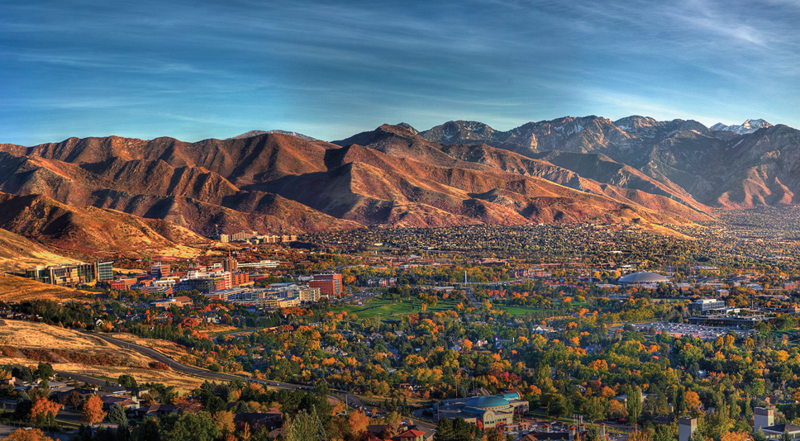
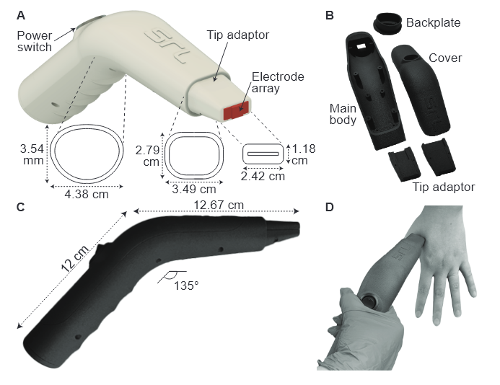

MILESTONE 1 UPDATE: Integrating Machine Learning Into UTAP App
<N
Hayden Walpole and Daniel McNally
Technical Advisor: Nathan Hansen & Prof. Benjamin Sanchez

Slide 2
MILESTONE 1 UPDATE: Integrating Machine Learning Into URSKIN App
<N
Hayden Walpole and Daniel McNally
Technical Advisor: Nathan Hansen & Prof. Benjamin Sanchez

Slide 3

Our Timeline
Milestone | Estimated Completion
Working Frontend UI | March 15th, 2025
Single Model ML Prototype | April 15th, 2025
Multiple Model ML Application | September 1st, 2025
Final Integrated Application | November 1st, 2025
Demo Day | December 5th, 2025

Slide 4
Team Contributions
Daniel
Hayden
User Interface
CITI Bio-Medical Research Training for Data Collection
Research: Conversion Tools
ONNX Implementation
Models used in Project
(Slide 8)
ADABoosting Model Testing:
-Default Data Array
-Measure Data from Device
FUTURE:
Data Collection
UI Finalization
Electrode Array Improvement
Individual Model Type Implementation
FUTURE:
Data Collection
Results validation and comparison to PC model
Unit Testing
Multi-Prediction Model

Slide 5
Original User Interface
User interface changes

Slide 6
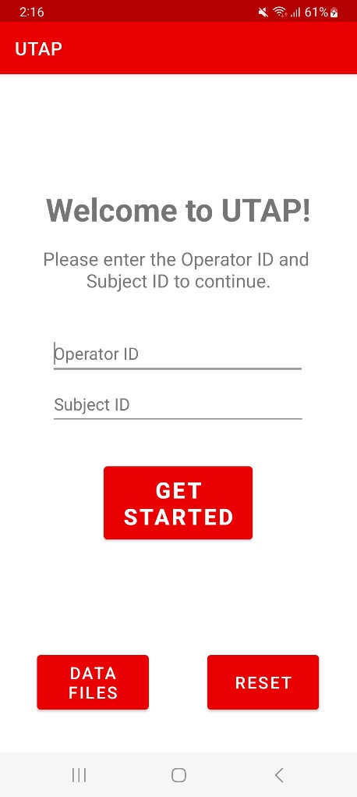
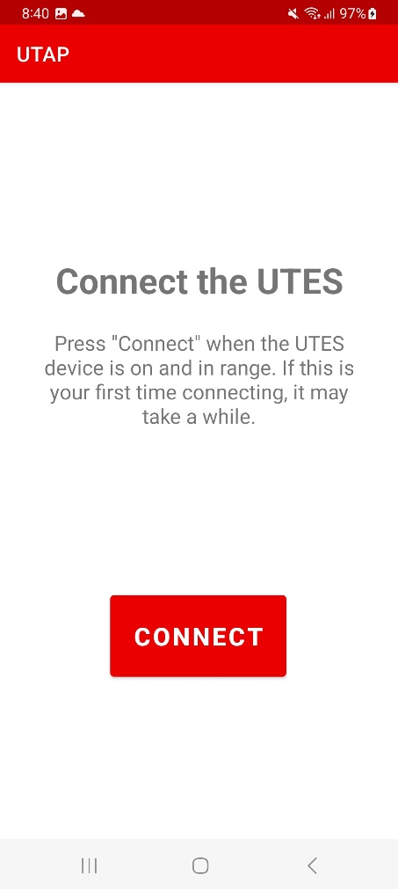
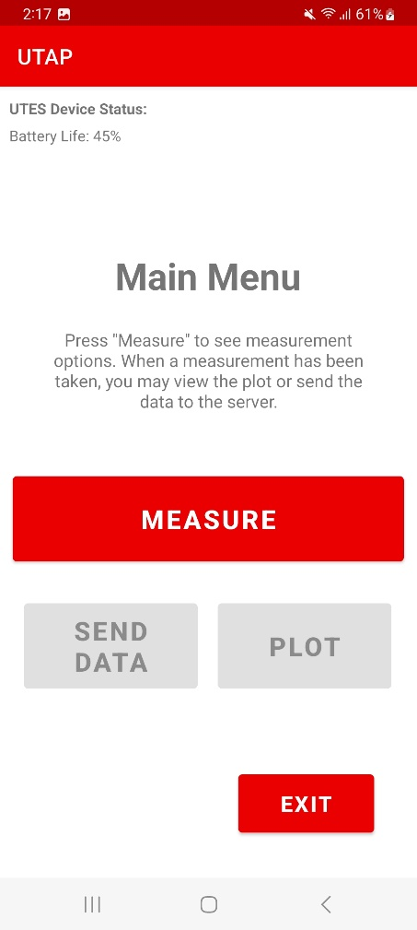
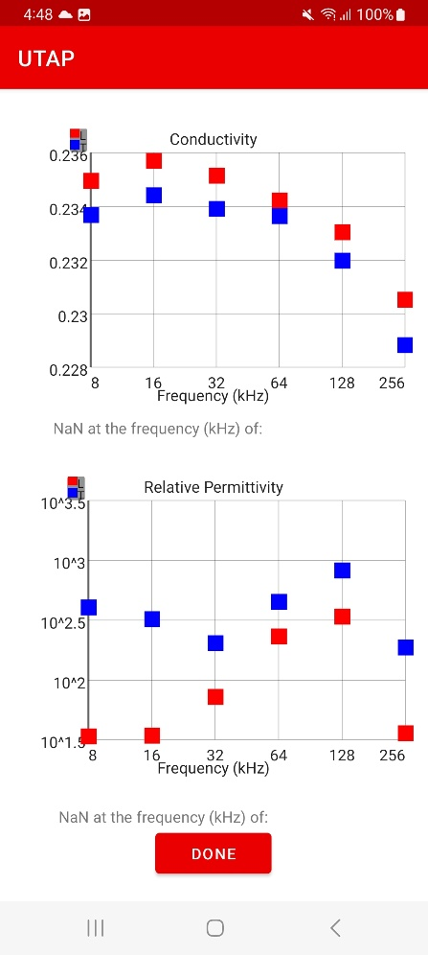
Original User Interface

Slide 7
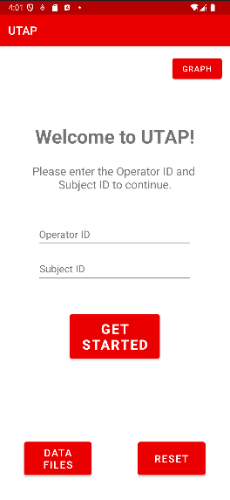
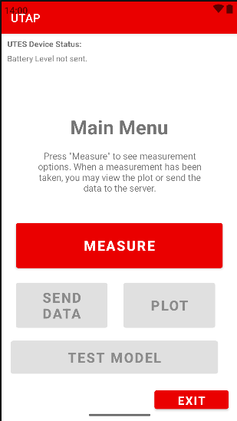
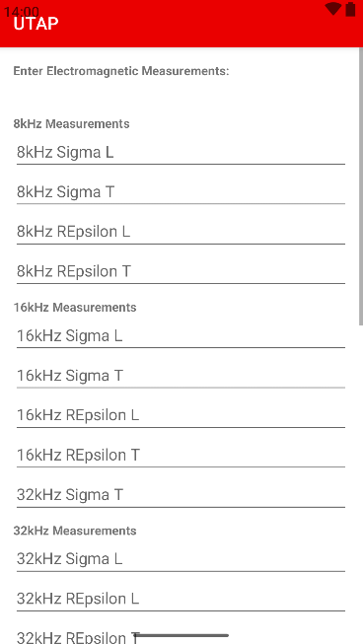
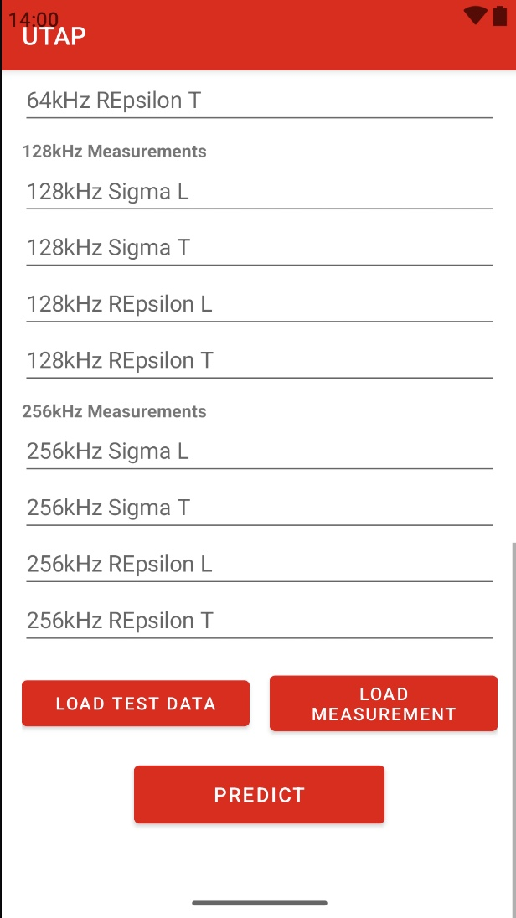
New User Interface

Slide 8
Original User Interface
Single Model ML Prototype

Slide 9
Machine Learning Models Involved
KNN
Decision Trees
Naive Bayes
Logistic Regression
Support Vector Machine
Random Forest
Adaboosting (base model decision tree stumps)
Extreme Gradient Boosting (base model decision tree stumps)
Gradient Boosting (base model decision tree stumps)
Bagged decision trees
Voting (based on the best three performing models for each comparison)
Stacking (based on the best three performing models for each comparison)

Slide 10
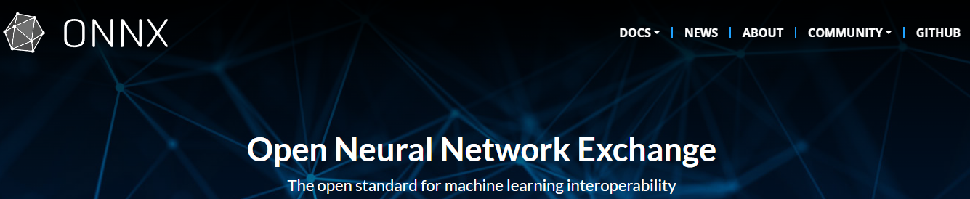
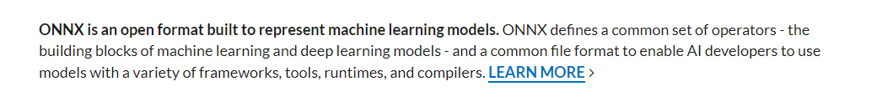
Transferring ML from Python to Mobile app
One of the first challenges we faced was finding the right conversion process to implement the existing models in Python into our mobile application.
We decided to use ONNX since it is well documented and well supported for our needs.

Slide 11
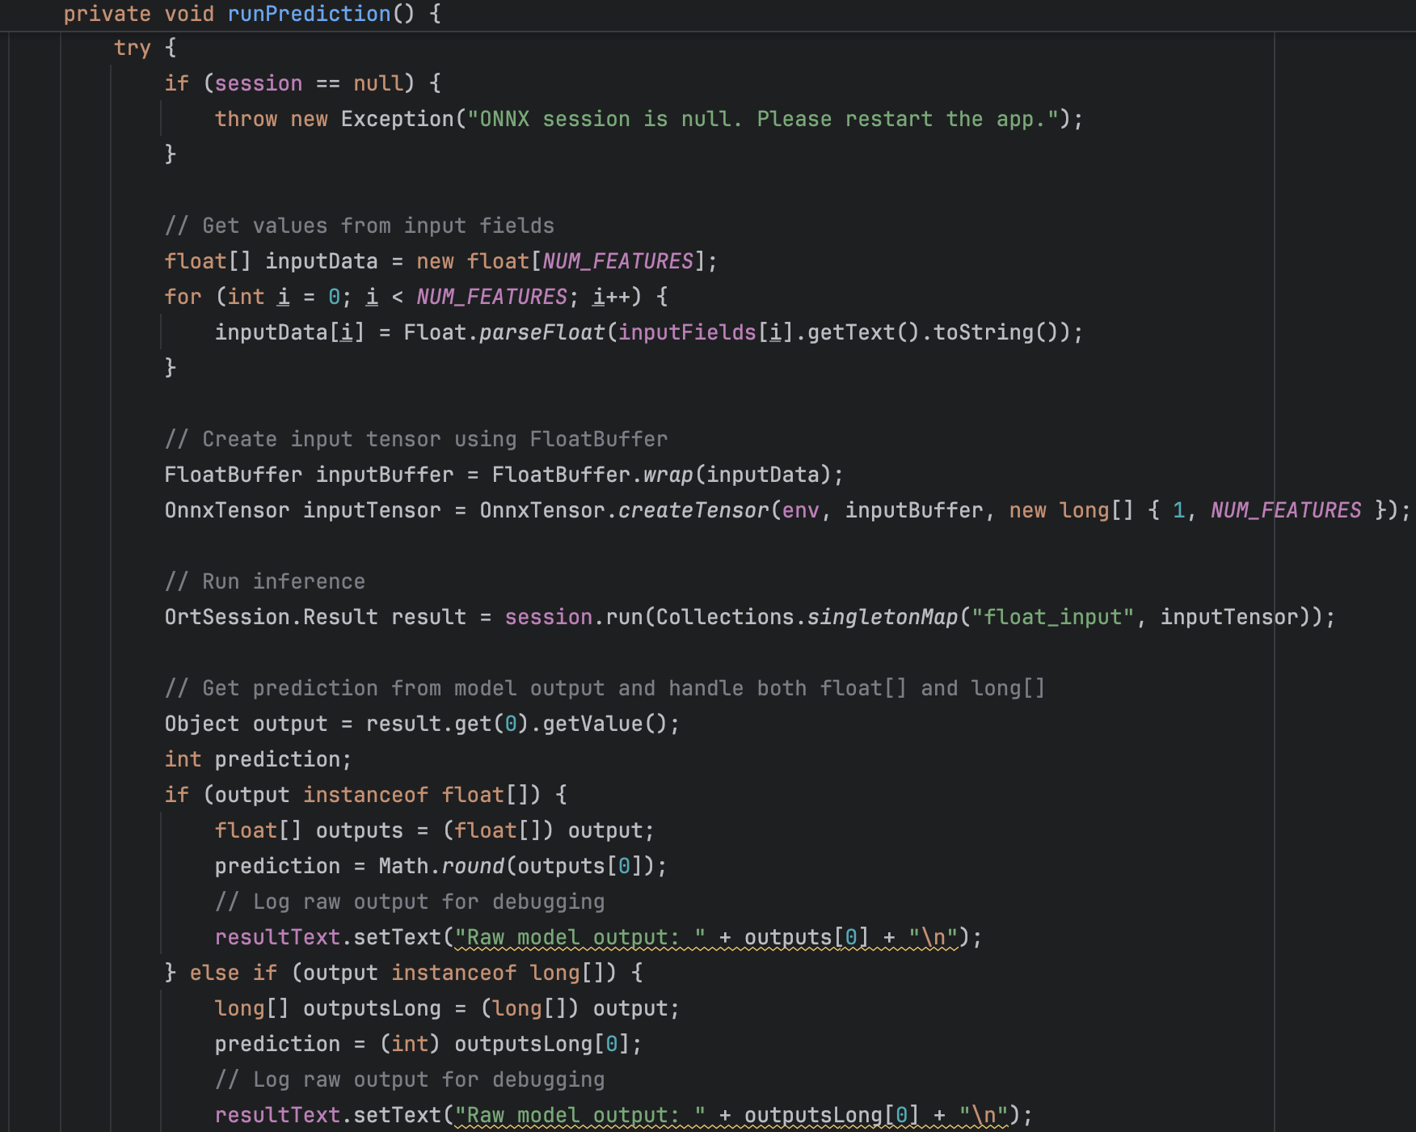
Code: Graph Activity
This was a new class activity we created to import and manage the Models we import from ONNX.

Slide 12
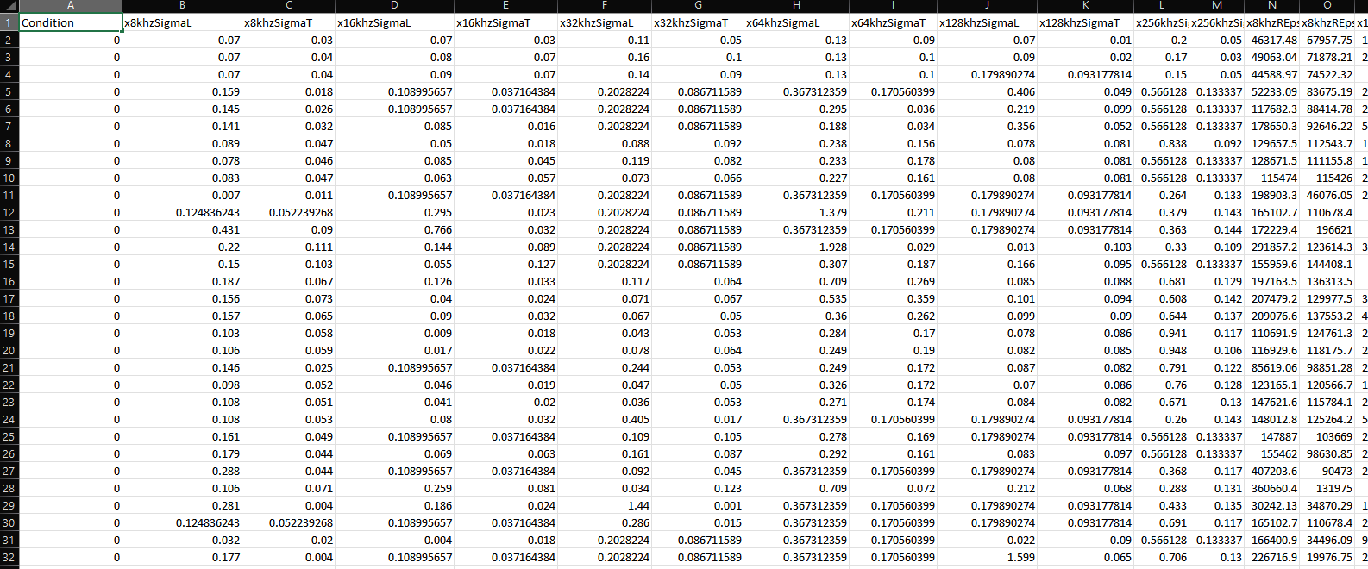
Data File

Slide 13
Thank You!
ADA BOOSTING DEMO
Healthy Vs SCC

Slide 14
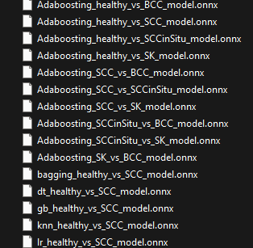
Plans going Forward
Our next Steps will be to refine the User interface and integrate more models.
The models are mostly 1 vs 1 Comparison, so multiple models are required to run the comparisons at once to get the final Prediction.

Slide 15
Thank You!
Questions?

Slide 16
Image Sources:
Images from ONNX mainpage found at https://onnx.ai/
Images from “UTES Training Guide V6” PowerPoint created by Nathan Hansen
Images from materials from the Sanchez Research Lab UTES Device Resources and Publications

